Slide 1
Comparative Performance Analysis between Cassandra and MongoDB in Tracking Efficiency of NBA Players
DATA 225 – Defense Presentation
Professor: Ming-Hwa Wang
San Jose State University
Iqra Bismi, Saniya Lande, Shilpa Shivarudraiah
(Project Group 4)

Slide 2
Output Generation
Output Analysis
Compare output against hypothesis
Agenda
Discussion
Summary Conclusion
Recommendation
DATA225 Defense Presentation
Comparative Performance Analysis - Cassandra Vs MongoDB
Notes:
This is the agenda for the presentation today.

Slide 3
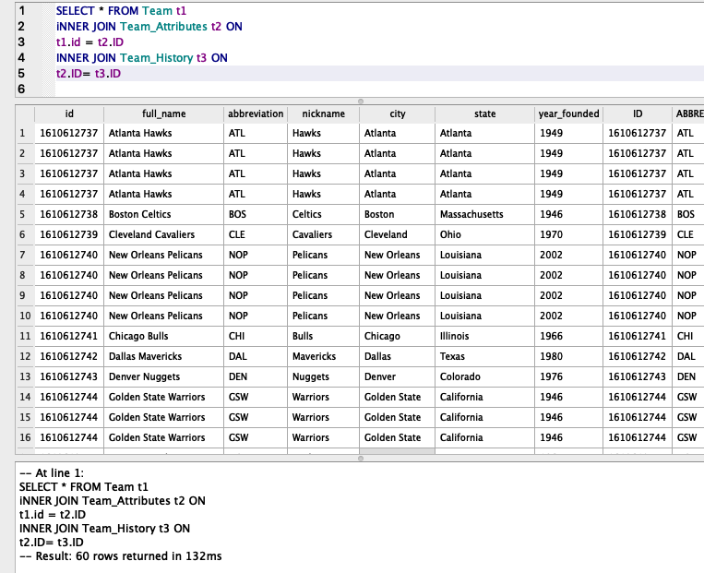
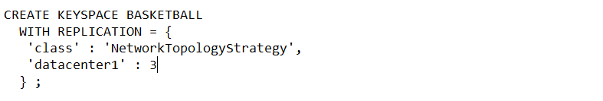
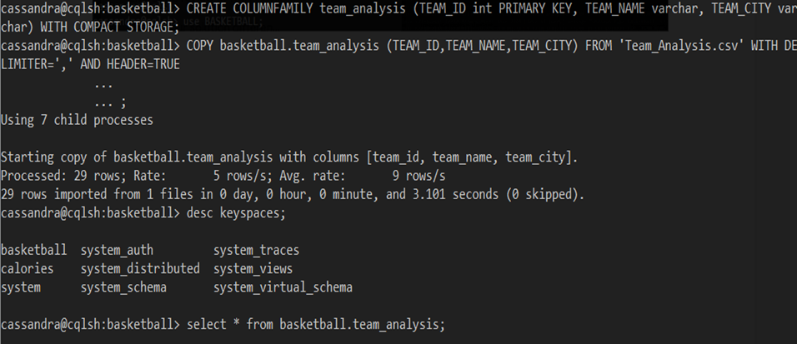
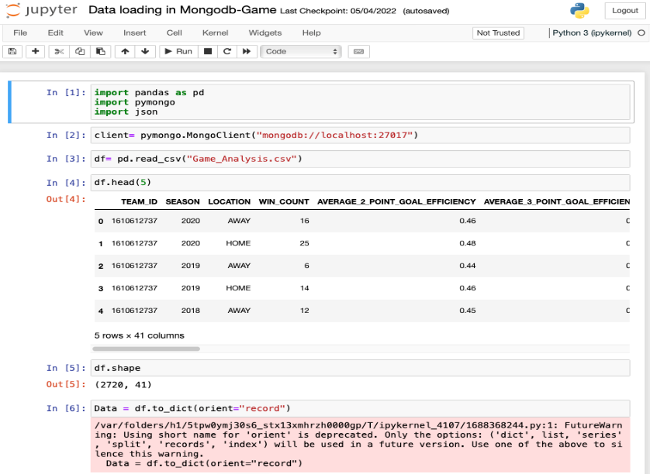
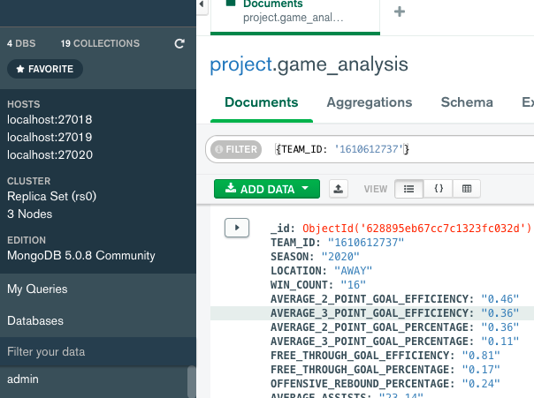
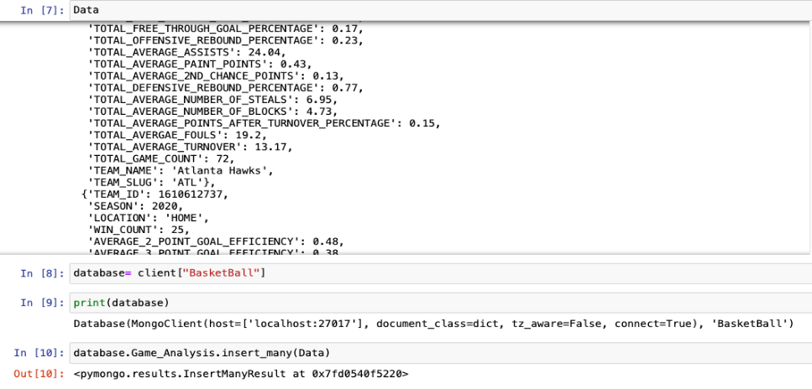
Output Generation
SQLite DB browser
Cassandra
MongoDB
DATA225 Defense Presentation
Comparative Performance Analysis - Cassandra Vs MongoDB
Notes:
This is the agenda for the presentation today.

Slide 4
Output Analysis & Discussion
Comparison of data loading time
The execution time required for loading data for both the databases
Data Loading | Number of Records | Cassandra (ms) | MongoDB (ms)
Team_analysis | 29 | 398 | 1
Player_analysis | 394 | 659 | 0
Game_analysis | 2720 | 4275 | 4
Basketball_analysis | 34567 | 103549 | 26
DATA225 Defense Presentation
Comparative Performance Analysis - Cassandra Vs MongoDB
Notes:
This is the agenda for the presentation today.

Slide 5
Output Analysis & Discussion
Comparison of execution time for various CRUD operations
The time taken for various CRUD operations for both the databases
CRUD Operations | Cassandra (ms) | MongoDB (ms)
Insert | 41.616 | 42
Read | 15.403 | 7
Update | 54.020 | 63
Delete | 33.122 | 5
DATA225 Defense Presentation
Comparative Performance Analysis - Cassandra Vs MongoDB
Notes:
This is the agenda for the presentation today.

Slide 6
Output Analysis & Discussion
Comparison of execution time for different consistency levels
CRUD | Consistency levels | Cassandra (ms) | MongoDB (ms)
Read | One | 225.147 | 1
 | Quorum | 228.763 | 5
Update | One | 108.951 | 70
 | Quorum | 162.396 | 556
Insert | One | 85.303 | 2
 | Quorum | 111.234 | 36
DATA225 Defense Presentation
Comparative Performance Analysis - Cassandra Vs MongoDB
Notes:
This is the agenda for the presentation today.

Slide 7
Output Analysis
Cassandra: Comparison of Read and Write latency
Read Operation |  | Write Operation
Count | Time Taken (ms) | Count | Time Taken (ms)
9 | 11.994 | 2 | .0118
5 | 10.532 | 3 | 0.239
14 | 10.311 | 10 | 0.8415
DATA225 Defense Presentation
Comparative Performance Analysis - Cassandra Vs MongoDB
Notes:
This is the agenda for the presentation today.

Slide 8
Output Analysis
MongoDB: Comparison of Read and Write latency
Read Operation |  | Write Operation
Count | Time Taken (ms) | Count | Time Taken (ms)
2 | 0.64 | 2 | 2.048
4 | 1.28 | 4 | 2.56
6 | 1.28 | 6 | 49.152
8 | 1.024 | 10 | 98.304
10 | 5.12 | 12 | 166.644
20 | 5.434 | 15 | 148.936
DATA225 Defense Presentation
Comparative Performance Analysis - Cassandra Vs MongoDB
Notes:
This is the agenda for the presentation today.

Slide 9
Compare output against hypothesis
Hypothesis 1 : “To test and verify if MongoDB performs better in CRUD operations and Cassandra performs better in write operations”
As per our analysis, we observe that MongoDB is better for READ and DELETE operation
Execution time for INSERT operation is almost similar for both the databases whereas Cassandra performs better for UPDATE operation
Hypothesis 2 : “To test and verify if Cassandra has low update and read latency as compared to MongoDB, when the load increases”
There is not a significant increase in read and write latency for Cassandra as the number of counts increases. However, for MongoDB, the write latency increases significantly with the increase in the number of write counts whereas there was a minimalistic increase in latency for read operation with the increase in number of counts
DATA225 Defense Presentation
Comparative Performance Analysis - Cassandra Vs MongoDB
Notes:
This is the agenda for the presentation today.

Slide 10
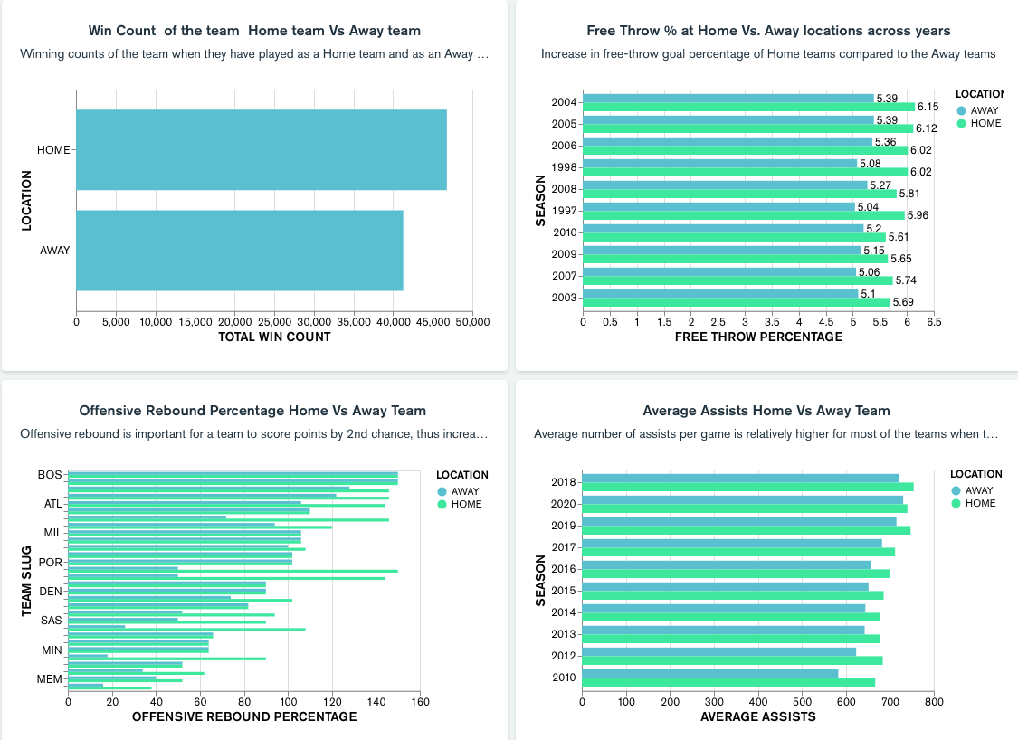
Performance evaluation for NBA Players

Slide 11
Summary & Conclusions
CRUD Operation
MongoDB loads the data faster in comparison to Cassandra
Except for UPDATE operation, MongoDB is more efficient than Cassandra for READ and DELETE operations.
Latency
Cassandra performed much better in terms of latency (lower latency) as the workload increased
Write latency for MongoDB increased significantly with increase in workload
Consistency
Cassandra and MongoDB: At consistency level one, the time required for each CRUD operation to be executed is low as compared to the time required for Quorum consistency
Data Visualization
Evaluated the performance of the NBA players using the MONGO charts in Atlas
Data analysis using mongo charts is more efficient as data is updated at regular intervals
DATA225 Defence Presentation
Comparative Performance Analysis - Cassandra Vs MongoDB
Notes:
This is the agenda for the presentation today.

Slide 12
Recommendations
More number of read and write operations can be performed to better understand the latency patterns as well as the CRUD operations of Cassandra and MongoDB
Analysis can be performed on larger datasets which shall help to get better understanding about performance of both the databases
Comparison between Cassandra and MongoDB can be done on real time data such as for on-field game analytics to get better insights of their performance metrics in real time
On-field game analytics can make use of Mongo charts for data analysis as the data is updated at regular interval
Horizontal scalability can also be measured by increasing the number of nodes
DATA225 Defense Presentation
Comparative Performance Analysis - Cassandra Vs MongoDB
Notes:
This is the agenda for the presentation today.

Slide 13

Thank you
Comparative Performance Analysis - Cassandra Vs MongoDB

